Slide 1

Predictive Analytics Project - Group 9
Fabian
Ajay
Priya

Slide 2
Index
Project Definition
Data Preparation
Model Building
Evaluation
Business update
Predictor Insight Graphs

Slide 3
Project Definition
The goal of the project is to help DSC (Non Profit organisation) target the customers that are more likely to donate during their next reactivation campaign.The target would be only those customers who are likely to donate more than 35 euro’s.
We would be using Logistic Regression as a prediction model to predict the number of customer for the next reactivation campaign
Data used for prediction:
Donors.csv – general information about donors
Gifts.csv – past reactivation campaign data
Campaign20130411.csv – Train dataset
Campaign20140115.csv – Test dataset

Slide 4
Project Definition
Timelines – The timelines used for prediction are below
Target
Target
Campaign data of 2013 and gifts data entry before these dates
Campaign data of 2014 and gifts data entry before these dates
April 2013
Nov
2014
Training Data
Test Data

Slide 5
Data Preparation
Training dataset:
To start with the Donors data set and Campaign201304 dataset was merged together with the DonorId which is the unique key
Then the gift dataset was filtered with the data of dates before 20130411 and then the statistical variables such as mean_donation,max_donation,min_donation,frequency and Recency were calculated.
This data was then merged with the overall donor and campaign dataset.
All the Donor's with the NA values for amount were removed.
Variables such as language and region were removed.
Dummy variables were created for gender and for the Zipcode
Test dataset:
The test data set was prepared in the same way as training, only difference being gift dataset was filtered with the data of dates before 20140115.

Slide 6
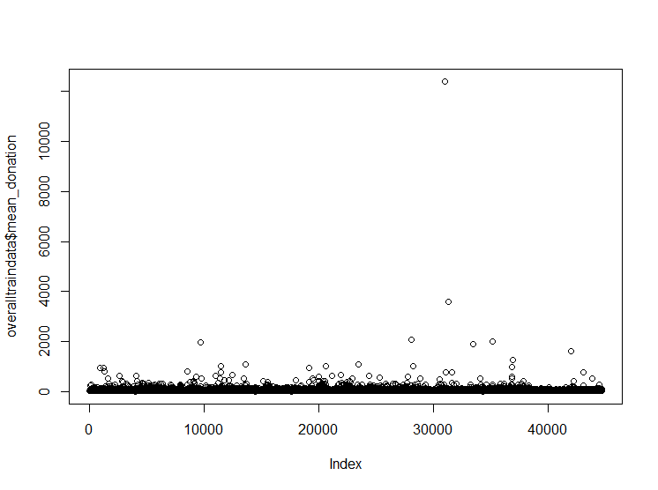
Data Preparation
Data Cleaning:
Target : Target was updated for train and test as people who donated < EUR 35 to be ‘0’ and those who donated more than EUR 35 as ‘1’ and this variable was named as ‘Donated’.
Outliers and NA values :There were very few observations with outliers and NA values which were deleted.

Slide 7
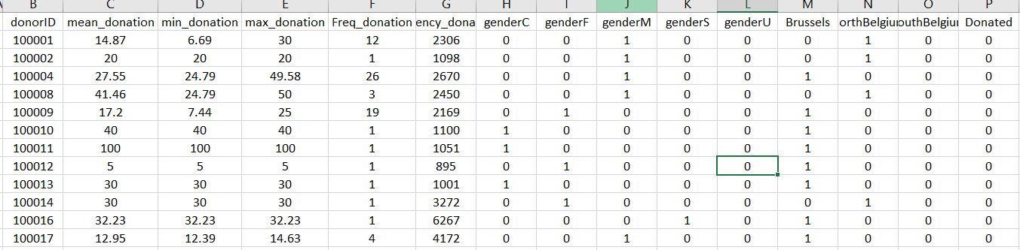
Data Preparation
Basetable was constructed after the data preparation with 15 variables variables including the target. The basetable has also been attached below

Slide 8
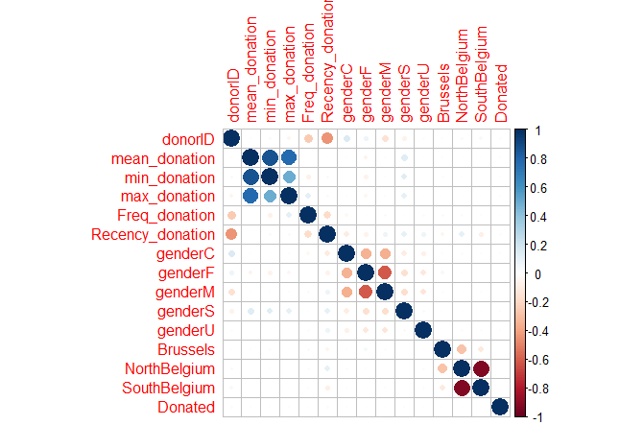
Data preparation
Correlation between variables
We checked the correlation bewteen the variables and deleted the ones which are highly correlated to avoid multicolinearity
From mean,min and max donation, min and max donation were deleted.
From gender, gender M was deleted
From the regions SouthBelgium was deleted

Slide 9
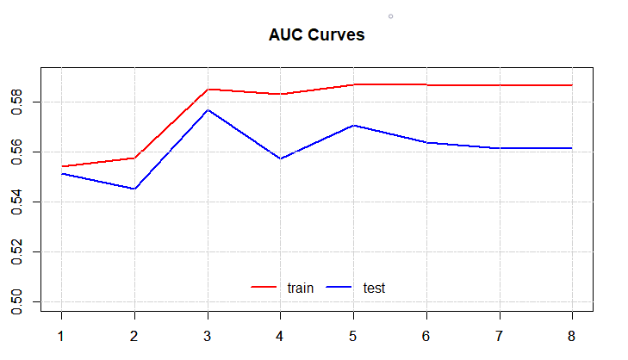
Model Building – Logistic Regression
Forward Stepwise selection model was used to select the variables, and based on the AUC graph the following variables were chosen to determine the AUC
Variables chosen : Recency_donation,genderU,genderS,genderF,mean_donation
Once the variables were selected Logistic Regression model was created and AUC was predicted from the same
AUC train: 0.586 AUC test: 0.570

Slide 10
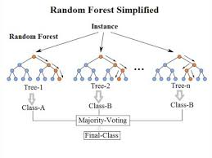
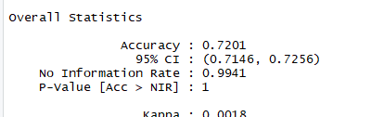
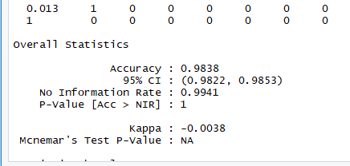
Model Building - Random forest
Importance
Parameters used were :
ntree=1000, maxnodes = 20
Variable | Importance
Recency_donation | 38.7660935
mean_donation | 32.0249355
genderF | 2.4455437
genderS | 0.8518668
AUC train: 0.9317 AUC test: 0.5137
Confusion Matrix
Tree=2k,Maxnodes=100
Tree=2k,Maxnodes=50

Slide 11
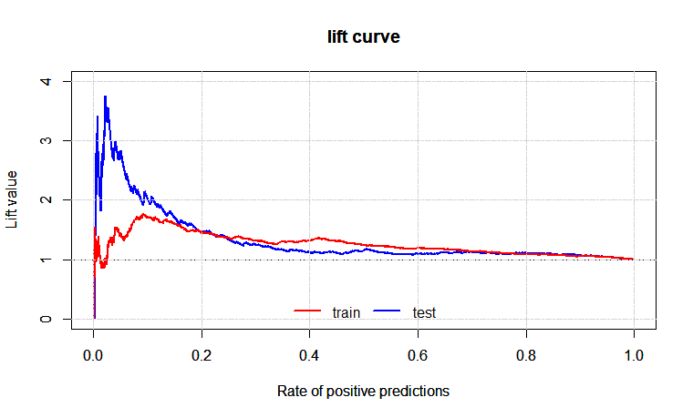

Evaluation and Business Case
Population: 44,686
Target Incidence: 1%
Reward: 46.5 Euros
Cost Campaign: 0.5 Euros
Percentage selected: 10%
Lift: 2
Benefit = 46.5 * 0.1 * (2 * 0.01) * 44,686 = 4,156
Cost = 0.5 * 0.1 * 44,686 = 2,234
Profit = 1,922 Euros
Profit without the model = - 156 Euros

Slide 12
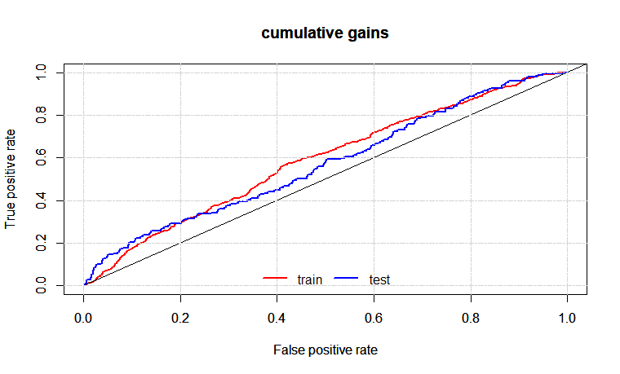
Evaluation and Business Case (Other example)
Population: 44,686​
Target Incidence: 1%​
Reward: 46.5 Euros​
Cost Campaign: 0.5 Euros​
Percentage selected: 20%​
Target reached: 30%
Benefit = 46.5 * 0.3 * 0.01* 44,686 = ​4,156
Cost = 0.5 * 0.2 * 44,686 = 4,469
Profit = 1,765 Euros
Profit without the model = - 313 Euros

Slide 13
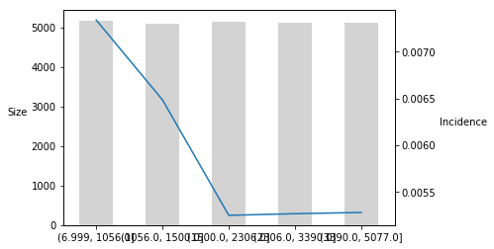
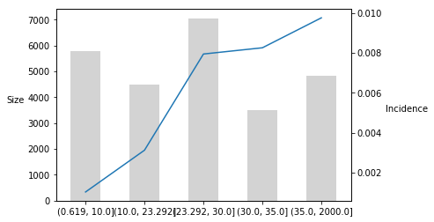
Predictor Insight Graphs for the variables
Recency from past donations
Mean from past donations
Donators that donated more recently are more likely to donate more than 35 Euros in the next reactivation campaign.
Donators with higher mean amount donated from past donations are more likely to donate more than 35 Euros in the next reactivation campaign.

Slide 14
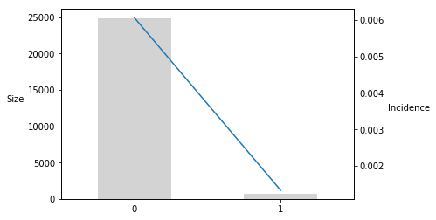
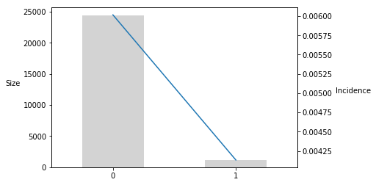
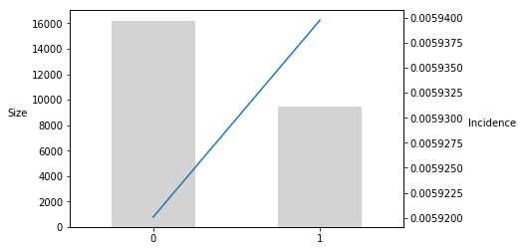
Gender U
Gender S
Donators with Gender U and Gender S are less likely to donate more than 35 Euros in the next reactivation campaign. This variables represent a small part of the Gender variable, so we assume that they refer to donators whose gender was not collected (maybe they didn't want to give this information).
Gender F
Females are slightly more likely to donate more than 35 Euros in the next reactivation campaign.

Slide 15
To conclude....
We should target the most recent donators with higher mean amount donated in the past
Female donators are slightly more likely to donate
We should avoid donators with unidentified gender
With our model, we can reach profits even selecting different percentages from our total population (10%, 20%)
Without the model, the campaign might not yield profits and the target donators would be random

